Slide 1
Semantic Representation by NMF

Slide 2
Task
用户-电影的特征表示
  用户兴趣的特征表示
  电影的主题模型（软聚类或语义抽象）
V_{(n*m)}
W_{(n*r)}
H_{(r*m)}
用户：943
=
×
r 设10
电影：1682
Notes:
V is an nxmmatrix whose columns are n-dimensional data vectors, where m is the number of vectors in the data set.
W is an nxr non-negative matrix
H is an rxm non-negative matrix
Usually, r is chosen to be smaller than n or m, so that W and H are smaller than the original matrix V

Slide 3
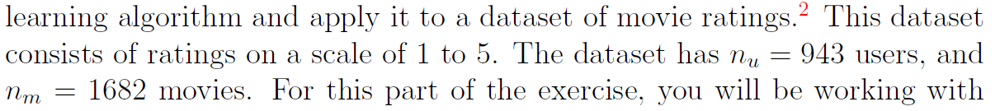
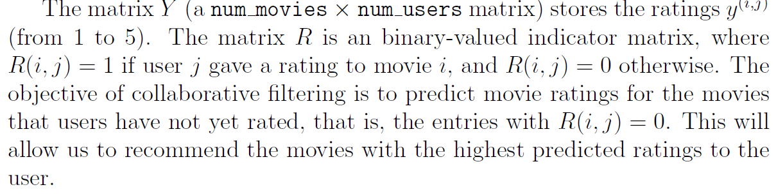
Description of Dataset
MovieLens Datasets from Univ. of Minnesota
Notes:
V is an nxmmatrix whose columns are n-dimensional data vectors, where m is the number of vectors in the data set.
W is an nxr non-negative matrix
H is an rxm non-negative matrix
Usually, r is chosen to be smaller than n or m, so that W and H are smaller than the original matrix V

Slide 4



Slide 5

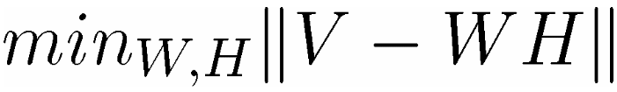
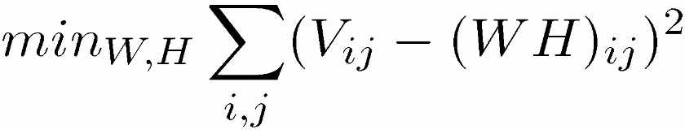
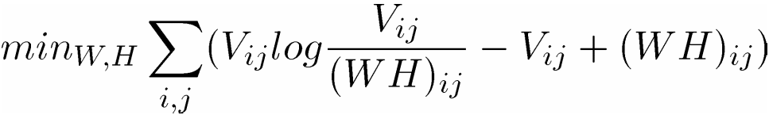
Cost Function
分解前后的误差：
损失函数：
使用欧式距离衡量误差
使用KL散度衡量误差
Notes:
V is an nxmmatrix whose columns are n-dimensional data vectors, where m is the number of vectors in the data set.
W is an nxr non-negative matrix
H is an rxm non-negative matrix
Usually, r is chosen to be smaller than n or m, so that W and H are smaller than the original matrix V

Slide 6
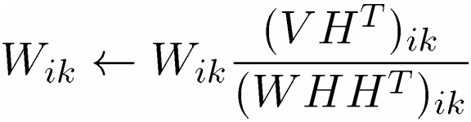
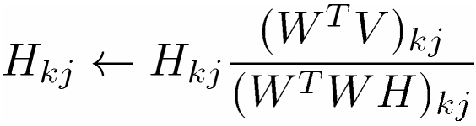
Algorithm
Algorithm NMF_Euclid
INPUT： V
OUTPUT：W, H
Randomize H;
Repeat
Update
Update
Until converge or maximal iterations
Notes:
V is an nxmmatrix whose columns are n-dimensional data vectors, where m is the number of vectors in the data set.
W is an nxr non-negative matrix
H is an rxm non-negative matrix
Usually, r is chosen to be smaller than n or m, so that W and H are smaller than the original matrix V

Slide 7
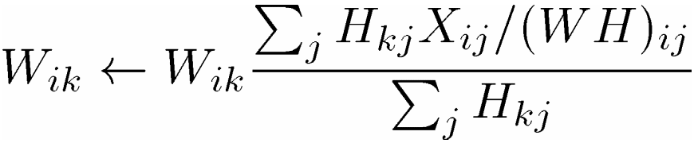
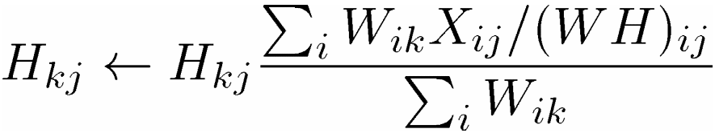
Optimization
更新规则：
Notes:
V is an nxmmatrix whose columns are n-dimensional data vectors, where m is the number of vectors in the data set.
W is an nxr non-negative matrix
H is an rxm non-negative matrix
Usually, r is chosen to be smaller than n or m, so that W and H are smaller than the original matrix V

Slide 8
Task
用两个NMF算法处理MovieLens数据集
得到用户兴趣的压缩表示后
  计算所有用户间的兴趣相似度；
  绘制相似度图

Slide 9
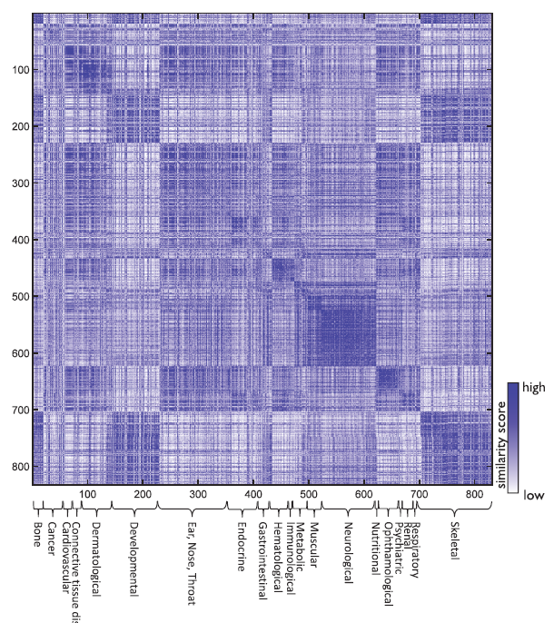
相似度热力图

Slide 10
Load Movie Name
fid = fopen('movie_ids.txt');
n = 1682; % Total number of movies
movieList = cell(n, 1);
for i = 1:n
line = fgets(fid);
[idx, movieName] = strtok(line, ' ');
movieList{i} = strtrim(movieName);
end
fclose(fid);

